Slide 1

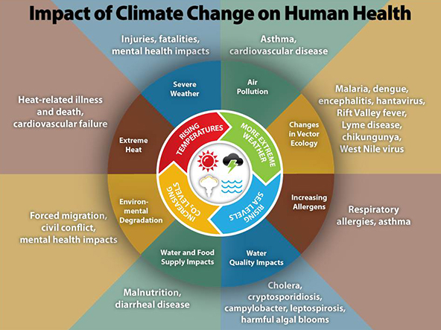
Weather-Disease Relationship
Group08: DataHeros
Chirag Gupta (chiragg4)
Jaqueline Ortiz (jortiz71)
Yihao Zhao (yihao4)
*Names are arranged in alphabetical order by last name
Course Project for STAT 430: Python in Data Science

Slide 2

Project Introduction
We are addressing the relationship between changes in weather and disease rates in the USA to identify possible reasons why people get sick. The goal of this project is to predict mortality rates based on weather trends. We aim to draw insights from model outputs.

Slide 3
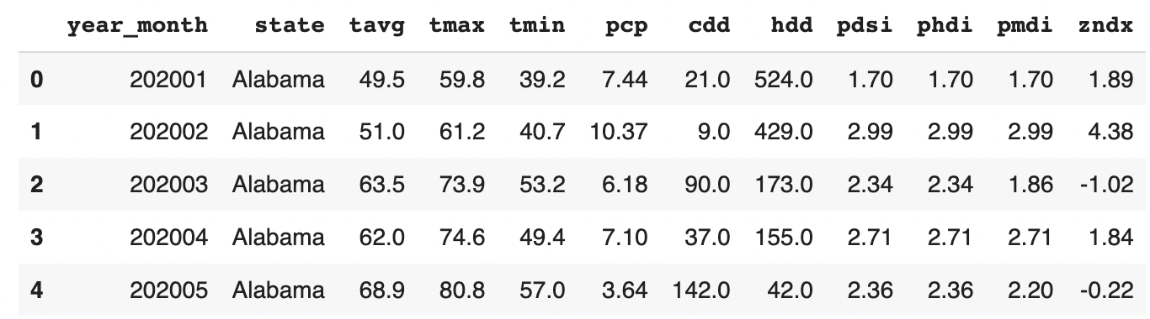
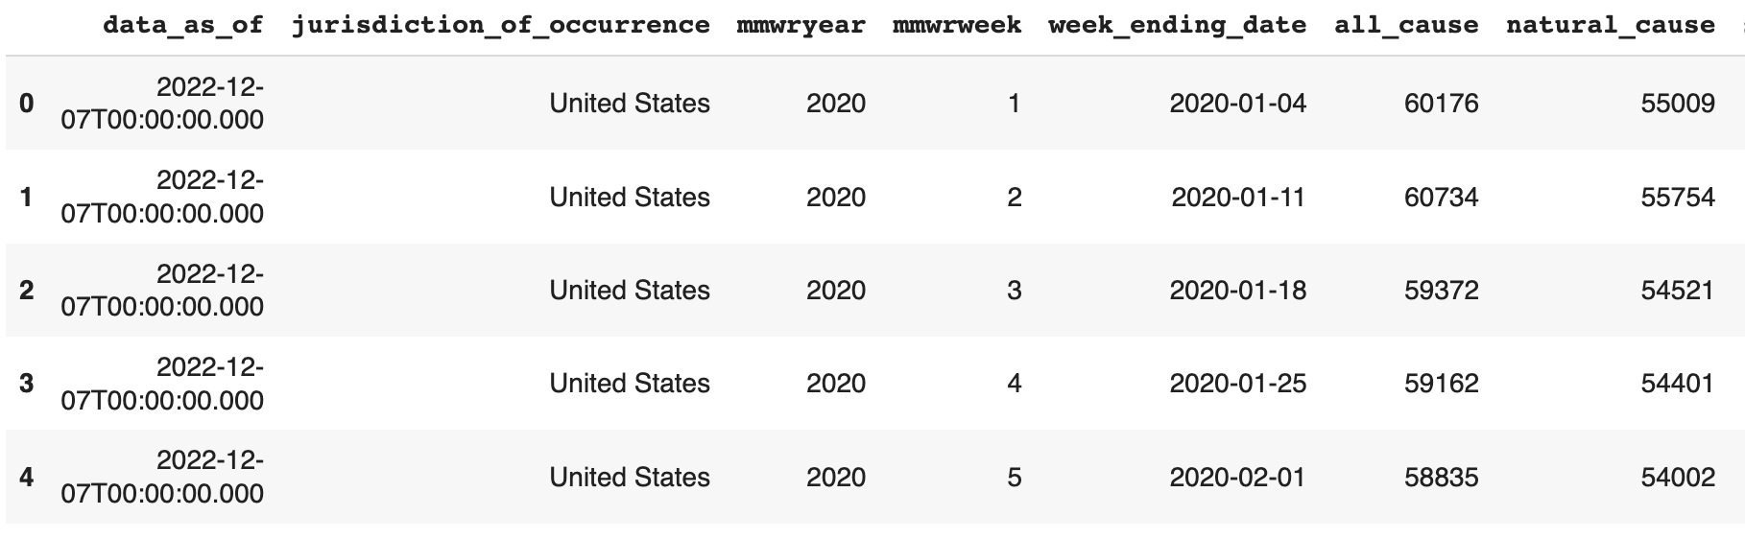


Project Introduction
Source of Data and Updated Frequency
Climate Data has 1728 records and 12 features. Disease Data has 8046 records and 35 features. The combined full dataset has 1728 records and 28 features.
The Climate Data was collected from the NOAA and is updated monthly. The Disease Data was collected from the CDC and is updated weekly.
First 5 rows of Climate data
First 5 rows of Disease data
Notes:
Jackie

Slide 4
Data Sources
(Climate data from NOAA) https://www.ncdc.noaa.gov/cdo-web/datasets
(Notified diseases by CDC) https://data.cdc.gov/NNDSS/NNDSS-Weekly-Data/ x9gk-5huc
Notes:
Jackie

Slide 5
Related Work
Patz, Jonathan A., David Engelberg, and John Last. “The Effects of Changing Weather on Public Health.” Annual Review of Public Health 21, no. 1 (2000): 271–307. doi:10.1146/ANNUREV.PUBLHEALTH.21.1.271.
Sheehan MC. 2021 Climate and Health Review – Uncharted Territory: Extreme Weather Events and Morbidity. International Journal of Health Services. 2022;52(2):189-200. doi:10.1177/00207314221082452
Garth Heutel, Nolan H. Miller, David Molitor; Adaptation and the Mortality Effects of Temperature across U.S. Climate Regions. The Review of Economics and Statistics 2021; 103 (4): 740–753. doi: https://doi.org/10.1162/rest_a_00936
C.H. & Fellingham, and S.A. Wyndham. Climate and Disease | South African Medical Journal. https://journals.co.za/doi/abs/10.10520/AJA20785135_18566.
Rohr, Jason R., et al. “Frontiers in Climate Change–Disease Research.” Trends in Ecology & Evolution, Elsevier Current Trends, 12 Apr. 2011, https://www.sciencedirect.com/science/article/pii/S0169534711000711?casa_token=L4qWKNJwZ6EAAAAA%3Ake0ZOrca4OO5ESBFpe1yTx16VNuqsUHSqnE2-ueGJIvr-qsjHp50tqNDcFmtdEfihdrOSBMmDHI.
Colwell RR, Patz JA. Climate, Infectious Disease and Health: An Interdisciplinary Perspective: A colloquium was convened by the American Academy of Microbiology to discuss research issues relating to the effects of climate on the incidence and distribution of infectious disease. The colloquium was held in Montego Bay, Jamaica, June 20–22, 1997. Washington (DC): American Society for Microbiology; 1998. Available from: https://www.ncbi.nlm.nih.gov/books/NBK559442/ doi: 10.1128/AAMCol.20Jun.1997
Prillaman, McKenzie. “Climate Change Is Making Hundreds of Diseases Much Worse.” Nature News. Nature Publishing Group, August 12, 2022. https://www.nature.com/articles/d41586-022-02167-z#:~:text=Increases%20in%20temperature%20and%20rainfall,waterborne%20illnesses%2C%20such%20as%20gastroenteritis.
Notes:
Jackie

Slide 6
Related Work
Prior Contributions
In the recent years, with the rise of climate change, there has been many scientific studies on the relationship between climate and health. Due to this, we understand weather changes and climate have an effect on disease rates. There has also been studies to identify the relationship between weather seasons and mortality. These studies provided background information on how to work with similar datasets.
How is this project different from prior work?
Most of the works were based on modeling weather data on specific diseases. We were focusing more on a general correlation between weather and casualties due to diseases. We draw conclusions based on statistical modelling and do not try to draw conclusions from preconceived notions due to science.
Notes:
Jackie

Slide 7
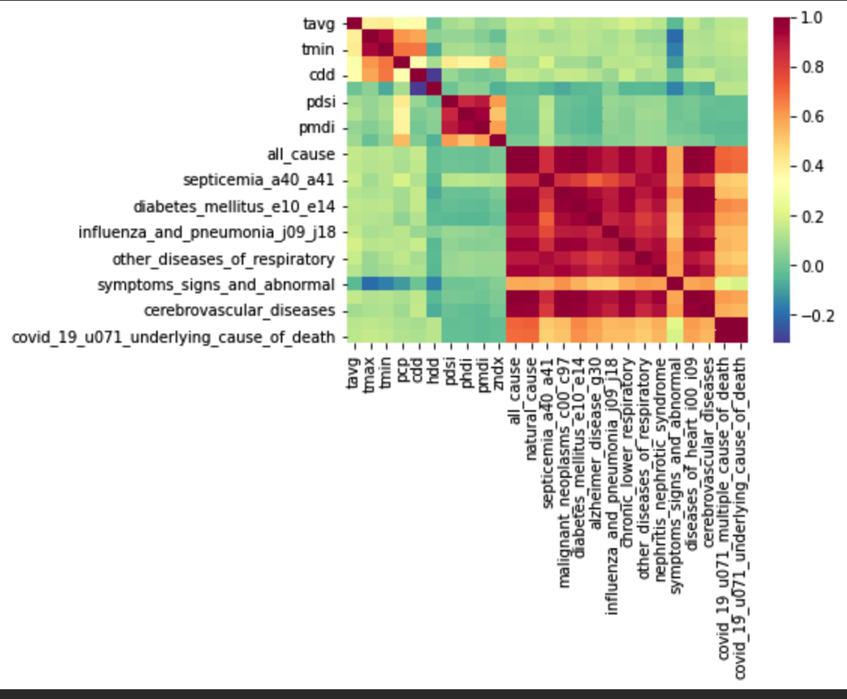
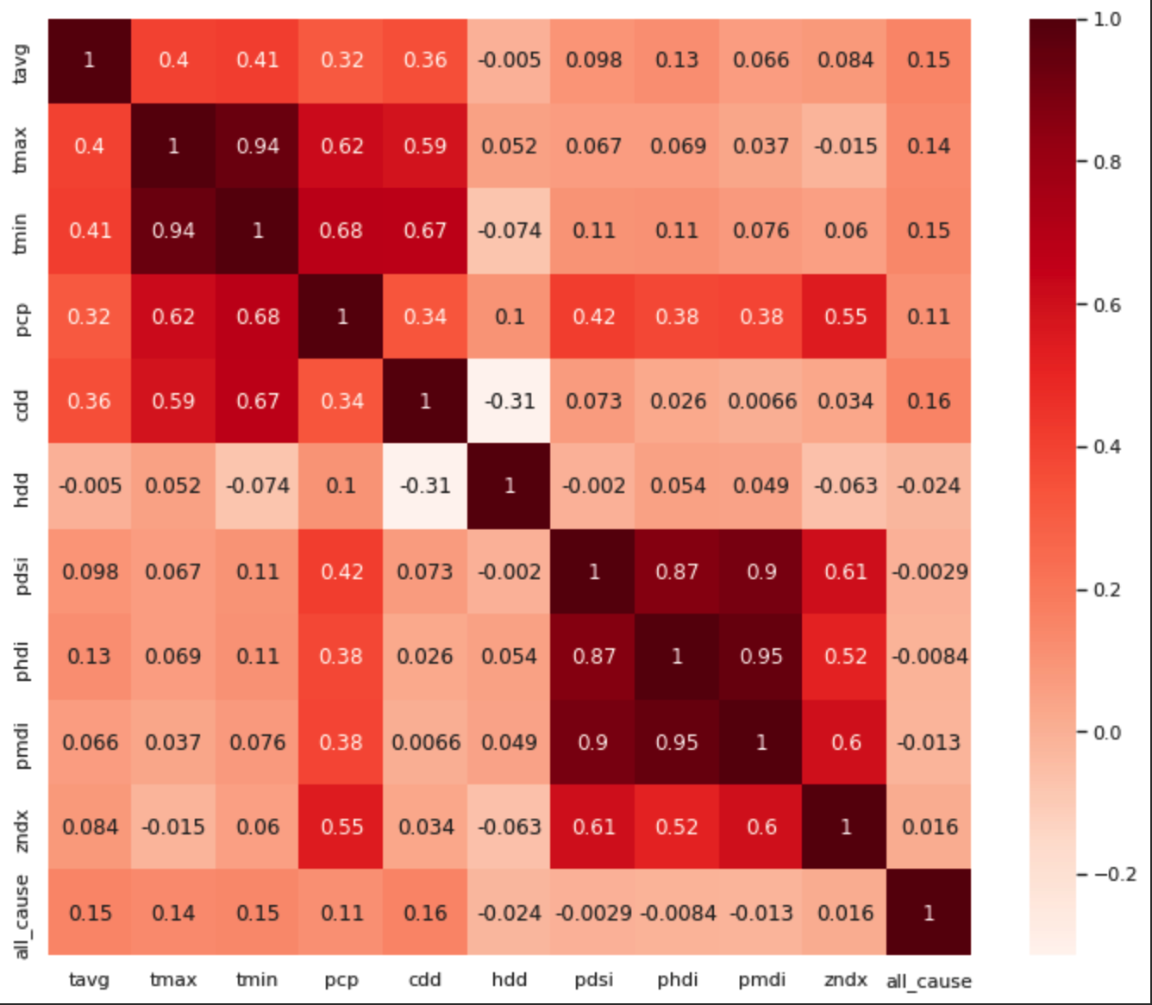
Exploratory Data Analysis
Correlation b/w variables
Notes:
The right side plot show the heatmap and the left shows the Correlation matrix of data and which seem to indicate that there exists little to no correlation between climate and disease.

Slide 8
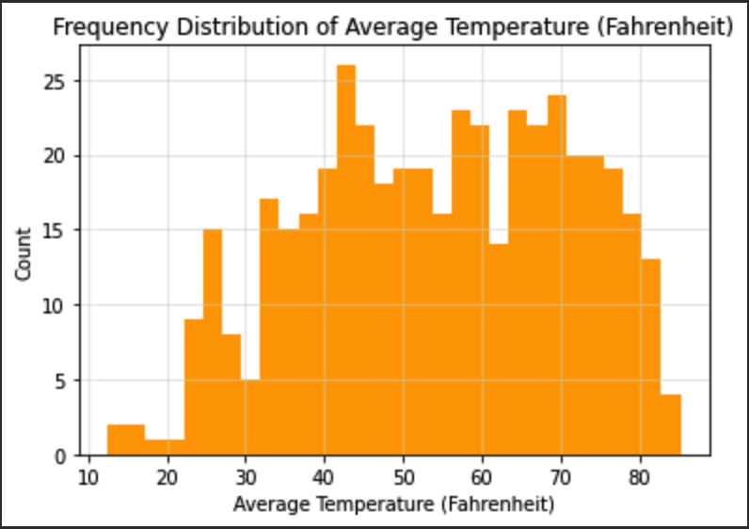
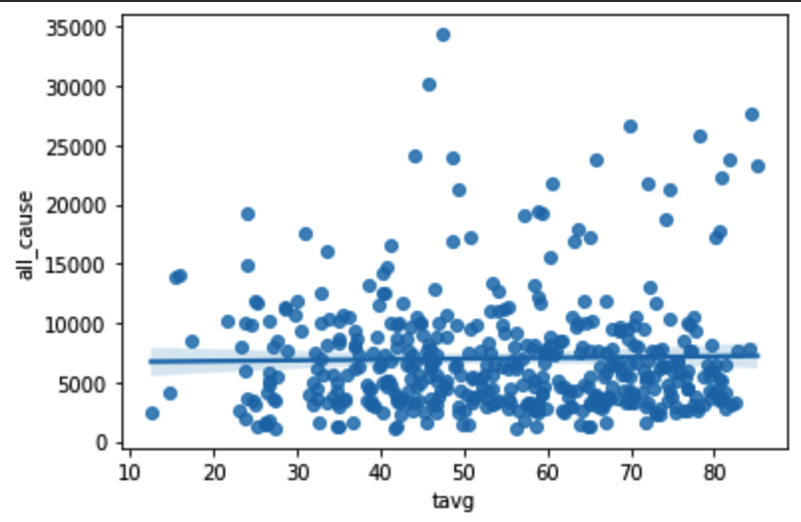
Exploratory Data Analysis
Histogram of average temperature
Average Temp vs Death by all causes
Notes:
Histogram of average temperature/ Scatterplot of average temperature with all deaths with Linear regression

Slide 9
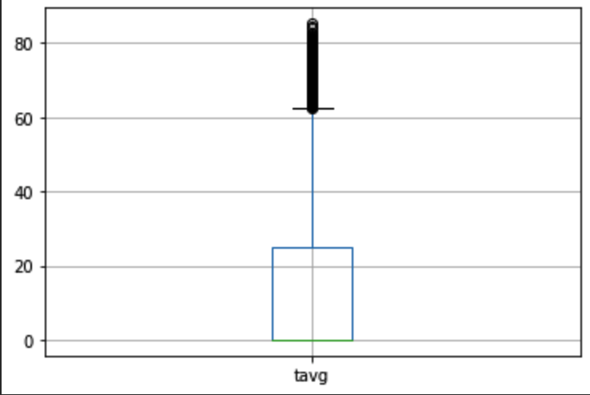
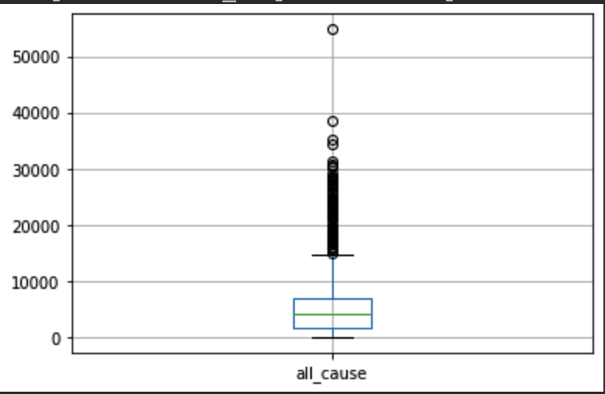
Exploratory Data Analysis
Boxplot of average temperature
Boxplot of deaths due to all causes

Slide 10
Methods
To demonstrate the relationship between the predictor variables (year, month, minimum temperature, precipitation, Palmer Hydrological Drought Index, Palmer Modified Drought Index, Palmer Drought Severity index, and Palmer Z index) and the response (Total Deaths), we fit the following three models
Linear Regression model
Random Forest Regression model
Gradient Boosting Regression model

Slide 11
Linear Regression
The first model we tried was a Linear Regression model with 8 predictor variables. This assumes that there is collinearity and we observed some interesting results
Slopes : [674.22, -82.8, 27.75, 6.09, 2.35, 141.92, 5.58, 0.44, -223.55, -125.09, 269.2, -17.06]
Intercept : -1357962.47

Slide 12
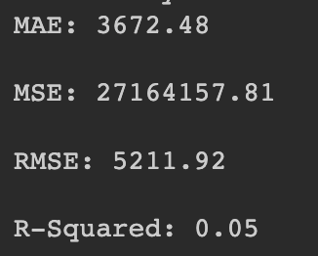
Results
We have a very high Root Mean Squared Error and low R-Squared score. This signifies that only around 5 percent of the variance of the response variable is explained by the variance of the predictor variables. This model is therefore not good enough to predict deaths and our initial assumptions were incorrect.

Slide 13
Future Improvements
We could take different datasets with different parameters as predictors. This might improve our models performance
Go through other research papers and learn more viable methods to conduct these analyses
Different models for different diseases might change results as some diseases might increase due to weather while others might decrease, which leads to normalization of deaths, thereby reducing our current models viability
Notes:
Jackie

Slide 14
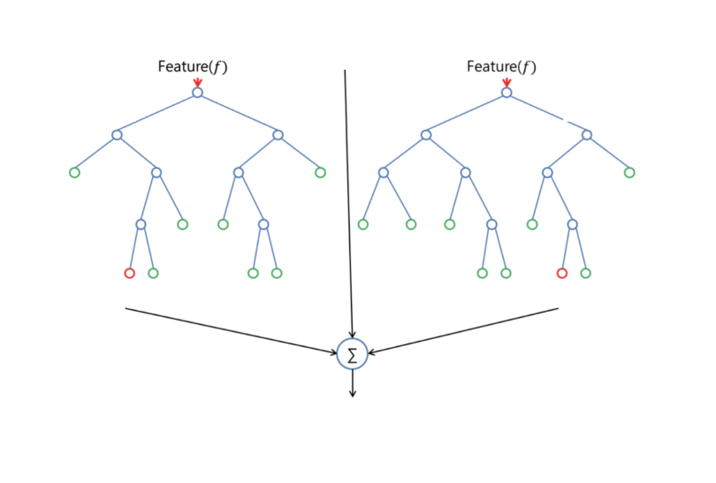
Random Forest Regression
The next model we tried was a Random Forest Regression model with 8 predictor variables. This constructs a multitude of decision trees at training time and then takes a combination of the best ones for results.

Slide 15
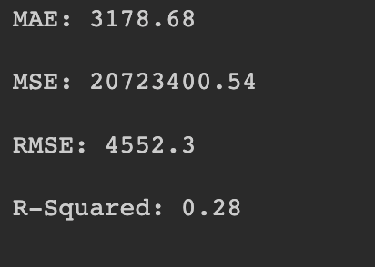
Results
We have a high Root Mean Squared Error and low R-Squared score. This signifies that around 28 percent of the variance of the response variable is explained by the variance of the predictor variables. This model is therefore still not good enough to predict deaths and seems to indicate that the given predictors aren’t enough to predict total deaths.

Slide 16
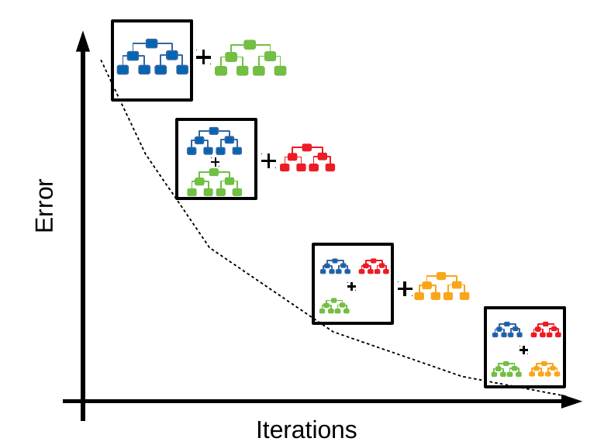
Gradient Boosting Regression
The next model we tried was a Gradient Boosting Regression model with 8 predictor variables. This is based on a group of machine learning algorithms that combine many weak learning models together to create a strong predictive model.

Slide 17
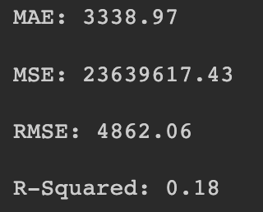
Results
We have a high Root Mean Squared Error and low R-Squared score. This signifies that only around 18 percent of the variance of the response variable is explained by the variance of the predictor variables. This model is therefore still not good enough to predict deaths and seems to indicate that the given predictors aren’t enough to predict total deaths.

Slide 18
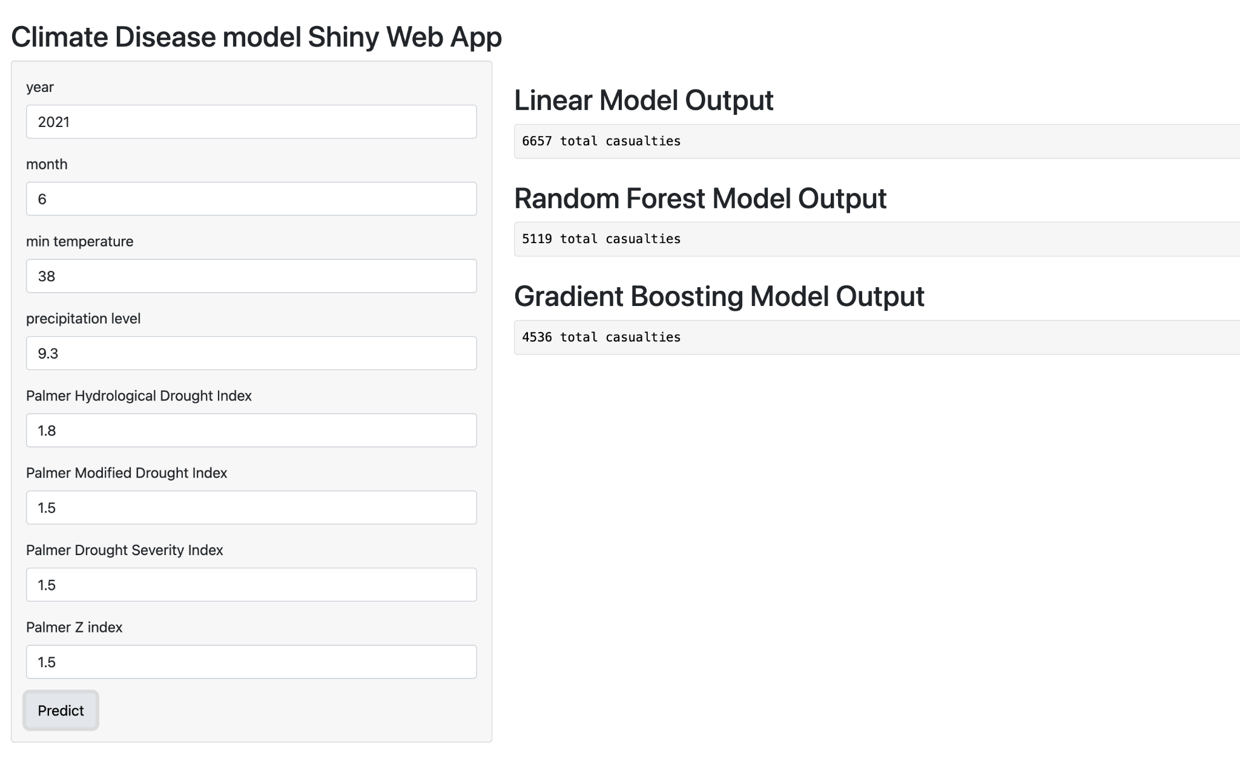
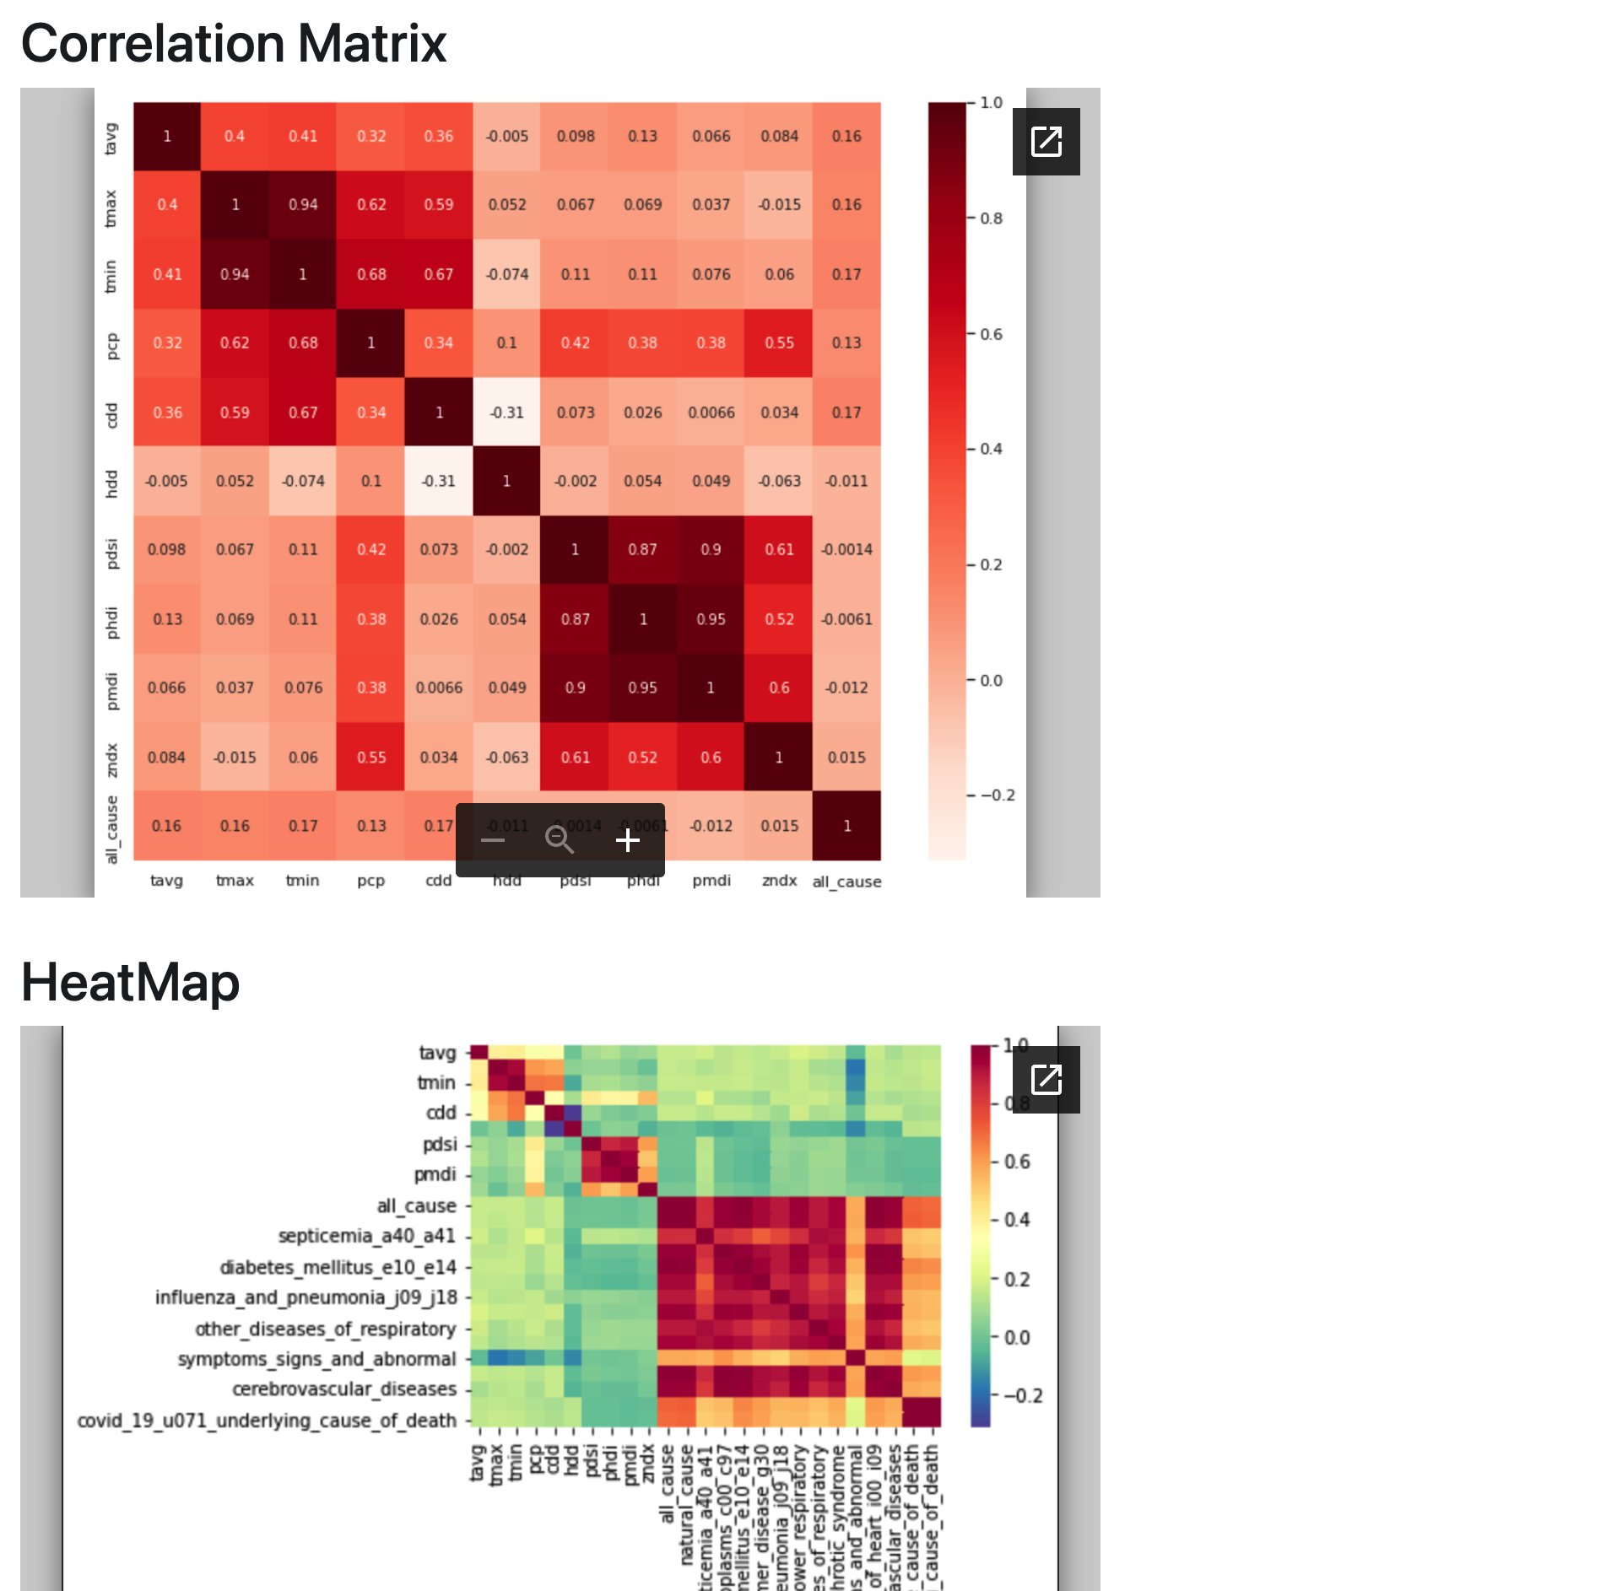
Shiny App

Slide 19
Conclusions
Based on our analyses through various models, we can say that the 8 given predictor variables do not give enough information to predict the total deaths as a response.
All 3 of our models seem to indicate a low correlation between these and this is in accordance with our exploratory data analysis in the beginning.
We might be able to predict it with more variables. However, as it stands, there seems to be no plausible connection between weather and total deaths based on our models

Slide 20

THANK YOU

